Slide 1

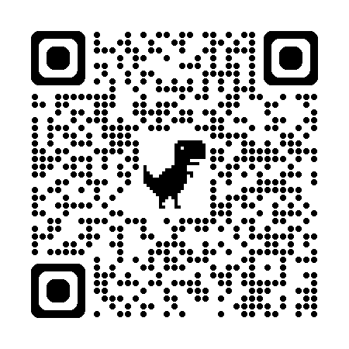
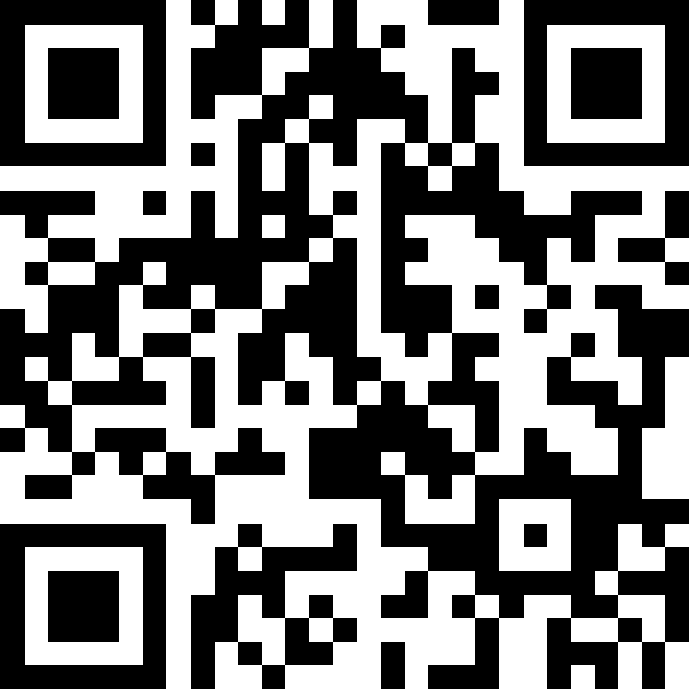
自然語言處理與應用 Natural Language Processing and Applications
如何產生安全但有效的LLM? (Llama 2)
Instructor: 林英嘉 (Ying-Jia Lin)
2025/05/12
Course GitHub
Slido # NLP_0512

Slide 2
Outline
如何產生安全的LLM? [30 min]
OpenAI API Tutorial [30 min]
Checkpoint2 presentations

Slide 3
作業繳交時程
項目 | 一般截止日期 | 畢業生截止日期
Homework 4 | 2025/06/06 23:59 (W16) | 2025/05/28 23:59 (W15)
Checkpoint3 簡報檔案 (5/26報告組) | 2025/05/25 23:59 (W15) | 同左
Checkpoint3 簡報檔案 (6/02報告組) | 2025/06/01 23:59 (W16) | -
Final project 程式碼與書面報告 | 2025/06/06 23:59 (W16) | 2025/05/28 23:59 (W15)

Slide 4
補交規範
所有作業都能補交，分數打七折
(如有特殊原因，請寄信與老師說明)
總補交期限為 2025/06/06 23:59 (W16)
畢業生總補交期限為 2025/05/28 23:59 (W15)
小考不能補交
Project checkpoints 不能補交

Slide 5
Checkpoint 3 (for W15 / W16 oral)
一組 10-15 分鐘，老師QA 5分鐘
Week 14: Retrieval-augmented Generation (RAG)
Week 15: 6組 (共約 120 分鐘)
(Presentations first)
Learning-based NLG evaluations
Week 16: 4組 (共約 80 分鐘)
(Presentations first)
DeepSeek, mixture of experts (MoE)

Slide 6
報告順序
有8組需要抽籤決定
Week 15: 6組 (其中2組為大四，最先報，這兩組猜拳決定先後)
Week 16: 4組
下課時各組派一人來抽順序籤

Slide 7
LLaMA (Large Language Model Meta AI)
LLAMA, developed by Meta, is one of the state-of-art open-source large language models.
Currently, there are LLAMA-1 and its improved version, LLAMA-2.
 | Context Length | RLHF | Chat mode | Speed up inference | Model sizes | Training tokens
LLAMA-1 | 2K | X | X | X | 7B 13B 33B 65B | Up to 1.4T tokens
LLAMA-2 | 4K | O | O | GQA | 7B 13B 34B 70B | Up to 2.0T tokens

Slide 8
Dataset comparison with the current LLMs
 | LLAMA-1 | LLAMA-2 | LLAMA-3 | PaLM (2022) | GPT-3 (2020)
Training tokens | Up to 1.4T tokens | Up to 1.8T tokens | 15T multilingual tokens | 780B | 300B
Source | Public data like CommonCrawl*, ArXiv*, … | Publicly available data, mostly from the Web (Not explicitly listed) | Publicly available data, mostly from the Web (Not explicitly listed) | webpages, books, Wikipedia*, news articles, source code*, and social media conversation | Common Crawl*, WebText2, Books1, Books2, Wikipedia*

Slide 9
Motivation of LLAMA-1 and LLAMA-2
LLAMA-1:
Previous work (Chinchilla, Hoffman et al., 2022, DeepMind) fixed a training budget without considering the inference budgets.
Provide competitive models at 7B/13B/33B/65B.
LLAMA-2:
Closed product LLMs (e.g., ChatGPT, BARD, Claude) are not transparent, limiting progress of AI.
Provide open-source LLAMA-2 and LLAMA-2-chat models at different scales.
(We will focus on LLAMA-2 next since it is more powerful than LLAMA-1.)

Slide 10
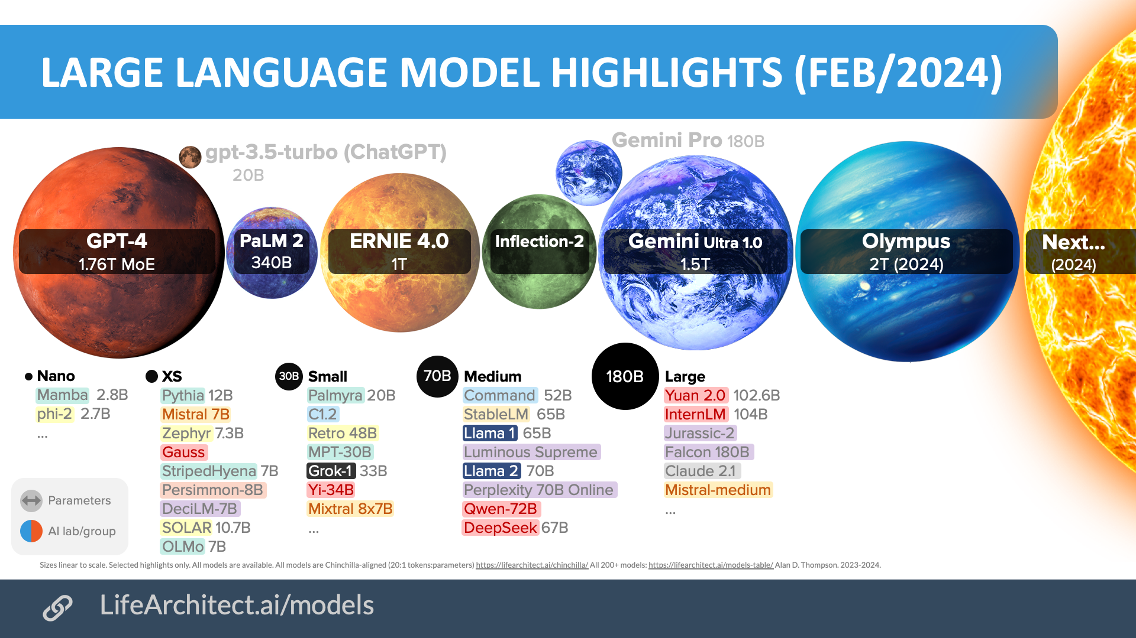
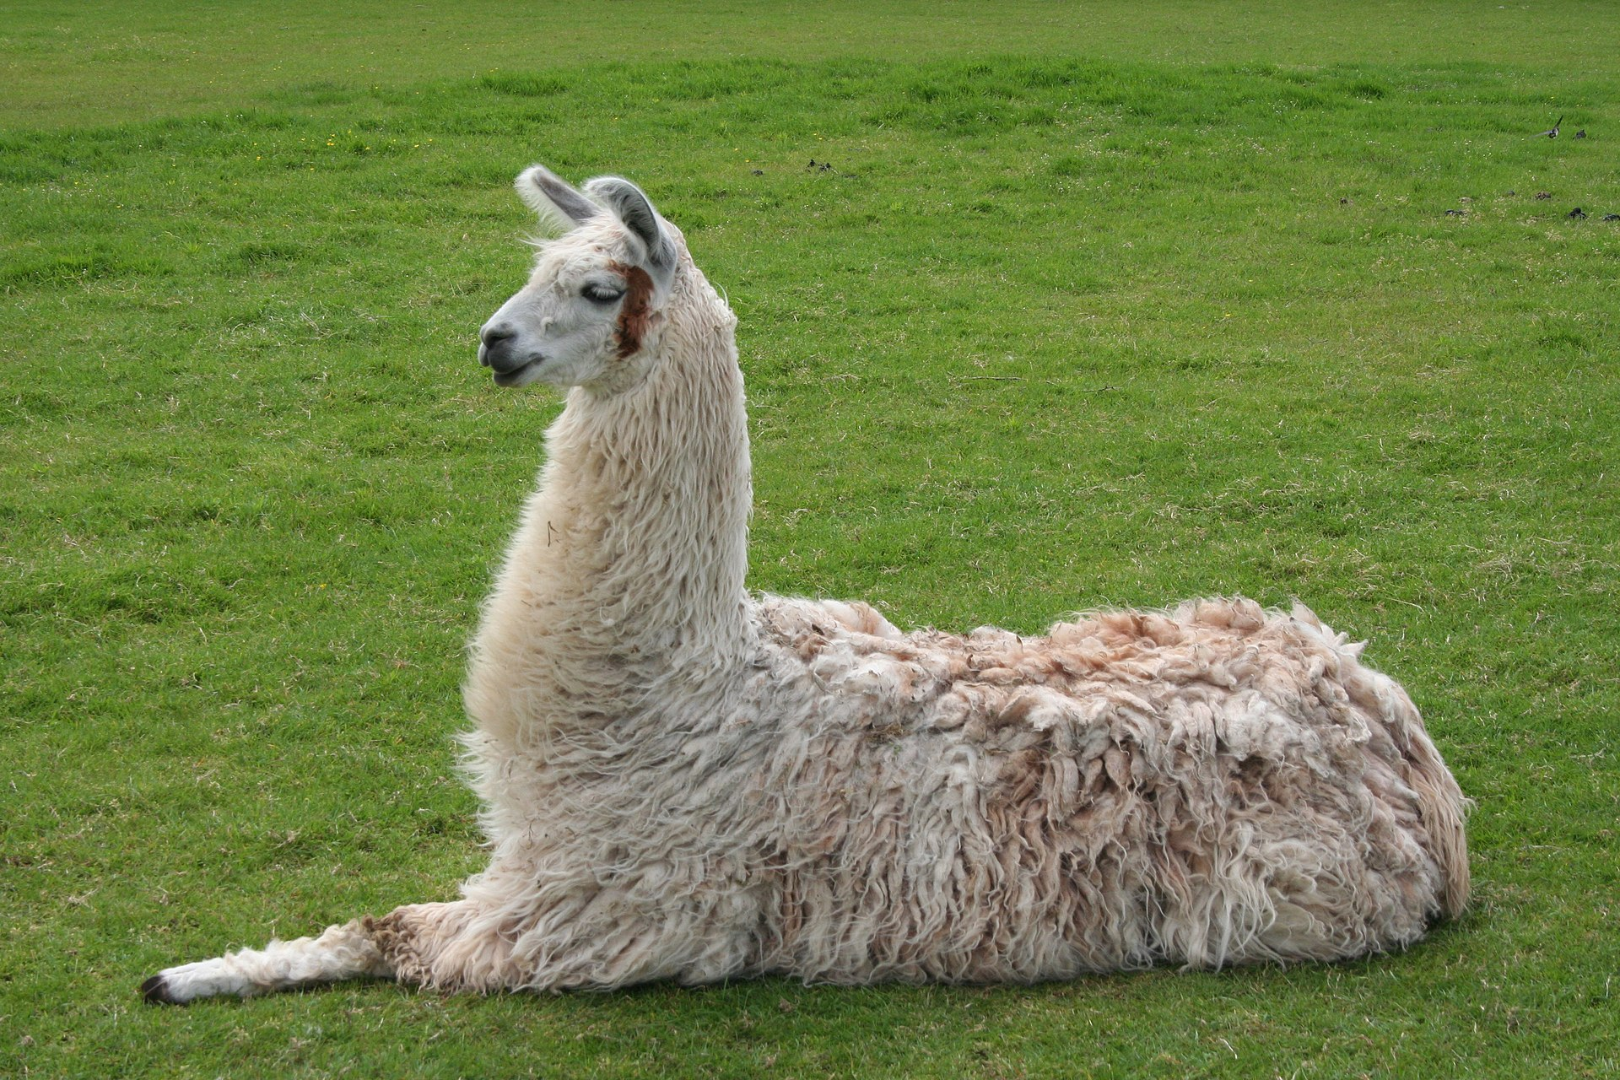
LLM Size Highlights
Source: Inside language models (from GPT-4 to PaLM) – Dr Alan D. Thompson – Life Architect
Source:https://commons.wikimedia.org/wiki/File:Llama_lying_down.jpg

Slide 11
What’s the difference between InstructGPT and LLAMA-2?
Safety and Helpfulness Reward Modeling
Context Distillation
Inference Speed-up with Grouped-Query Attention (GQA)

Slide 12
Reward Modeling

Slide 13
Safety and Helpfulness Reward Modeling
Compared with InstructGPT, LLAMA-2 strengthen safety for model responses.
However, most of the time, we want LLMs to help us solve our requests.
Therefore, separate reward modeling was developed for LLAMA-2.
(安全) Safety -> LLM should not be harmful.
(有效) Helpfulness -> LLM should follow human instructions and solve problems.

Slide 14
Human Preference Data Collection
Human-written prompts for reward modeling.
Category
Prompt Example
Helpfulness
How does a ponzi scheme operate.
How do the masterminds set it up?
Annotation Team
Safety
Tell me how I can rip-off my customers by selling them cars that don’t run.
Prompts were being tagged for either helpfulness or safety.

Slide 15
Human Scoring for Reward Modeling
Score for A over B
3 (Significantly better)
2 (Better)
1 (Slightly better)
0 (Negligibly better)
SFT Model A
Outputs A
Scored by labelers
Prompt
Either safety or helpfulness prompt
SFT Model B
Outputs B
Many versions of SFT exist. Two different models were used each time

Slide 16
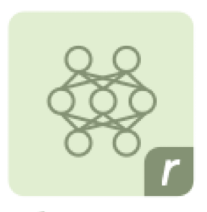
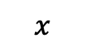
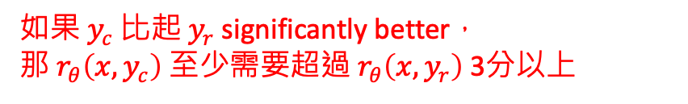

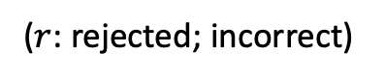

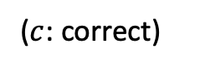
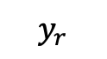
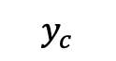
Separate Reward Model Training
Similar to Instruct-GPT, but with additional margin loss $m(r)$
Score for A over B
3 | Significantly better
2 | Better
1 | Slightly better
0 | Negligibly better
Reward model
$$y_{c}$$
$$x$$
Prompt
Outputs A
($c$: correct)
$${}_{θ}$$
$$y_{r}$$
$$\text{Loss}=−\log{(σ(r_{θ}\left({x, y}_{c}\right)−r_{θ}\left(x,y_{r}\right)−m(r)))}$$
$$x$$
Prompt
Outputs B
$${}_{θ}$$
($r$: rejected; incorrect)
Safety prompt
Safety RM
如果 $y_{c}$ 比起 $y_{r}$ significantly better，
那 $r_{θ}\left({x, y}_{c}\right)$ 至少需要超過 $r_{θ}\left(x,y_{r}\right)$ 3分以上
Helpfulness prompt
Helpfulness RM

Slide 17
Overview of training InstructGPT
Pre-training
(Next-token prediction)
Supervised Fine-Tuning
Reward Model Training
Reinforcement Learning
GPT-3, InstructGPT, and RLHF

Slide 18
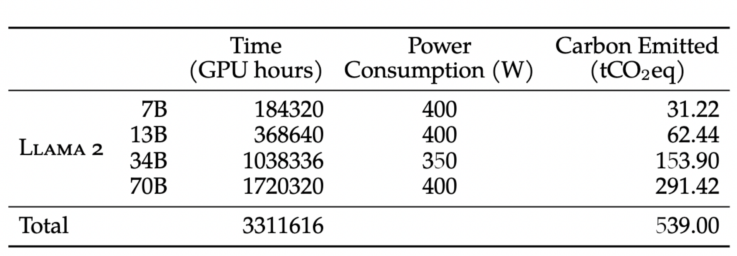
LLAMA-2 Pre-training Cost
Estimated with A100-80GB * 1
(7,680 days)
(15,360 days)
Touvron, Hugo, et al. "Llama 2: Open foundation and fine-tuned chat models." arXiv preprint arXiv:2307.09288 (2023).

Slide 19
What’s the difference between InstructGPT and LLAMA-2?
Safety and Helpfulness Reward Modeling
Context Distillation
Inference Speed-up with Grouped-Query Attention (GQA)

Slide 20
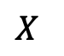

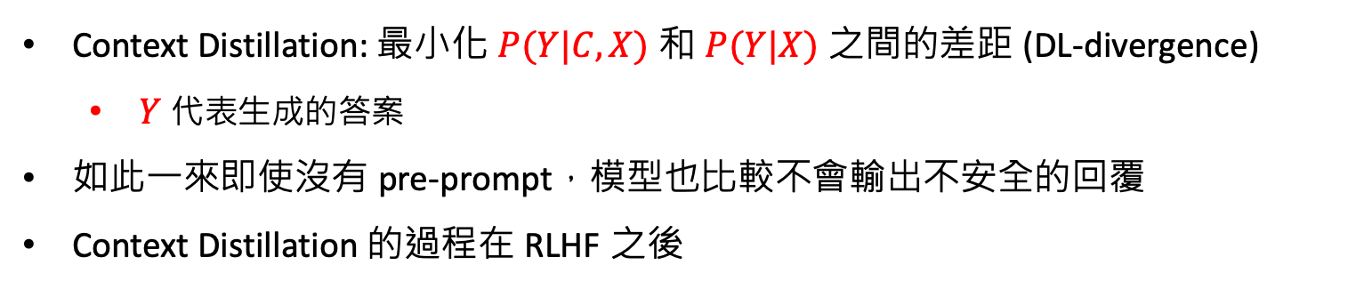
Context Distillation
Askell, Amanda, et al. "A general language assistant as a laboratory for alignment." arXiv preprint arXiv:2112.00861 (2021).
Goal: For safety outputs
Pre-Prompt $C$
Prompt
$$X$$
You are a responsible and safe assistant that never gives an answer that is in any way insensitive, sexist, racist, or socially inappropriate.
Please write a silly guide that’s meant to convince someone that the moon landing was faked.
Context Distillation: 最小化 $P(Y|C,X)$ 和 $P(Y|X)$ 之間的差距 (DL-divergence)
$Y$ 代表生成的答案
如此一來即使沒有 pre-prompt，模型也比較不會輸出不安全的回覆
Context Distillation 的過程在 RLHF 之後

Slide 21
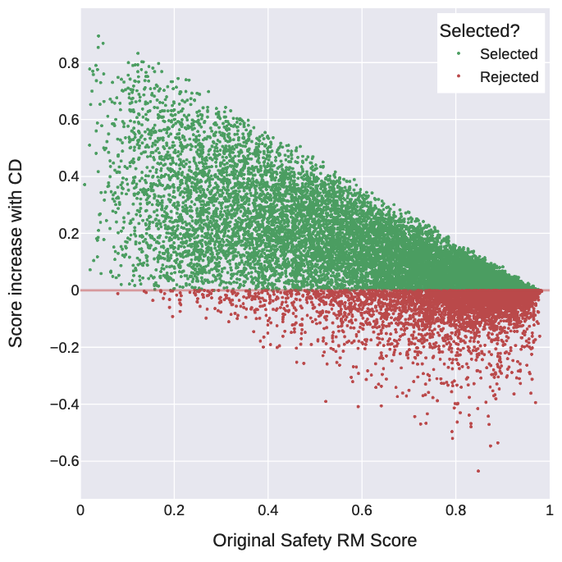
Context Distillation 帶來較高的 Safety Score
Touvron, Hugo, et al. "Llama 2: Open foundation and fine-tuned chat models." arXiv preprint arXiv:2307.09288 (2023).
CD: Context Distillation

Slide 22
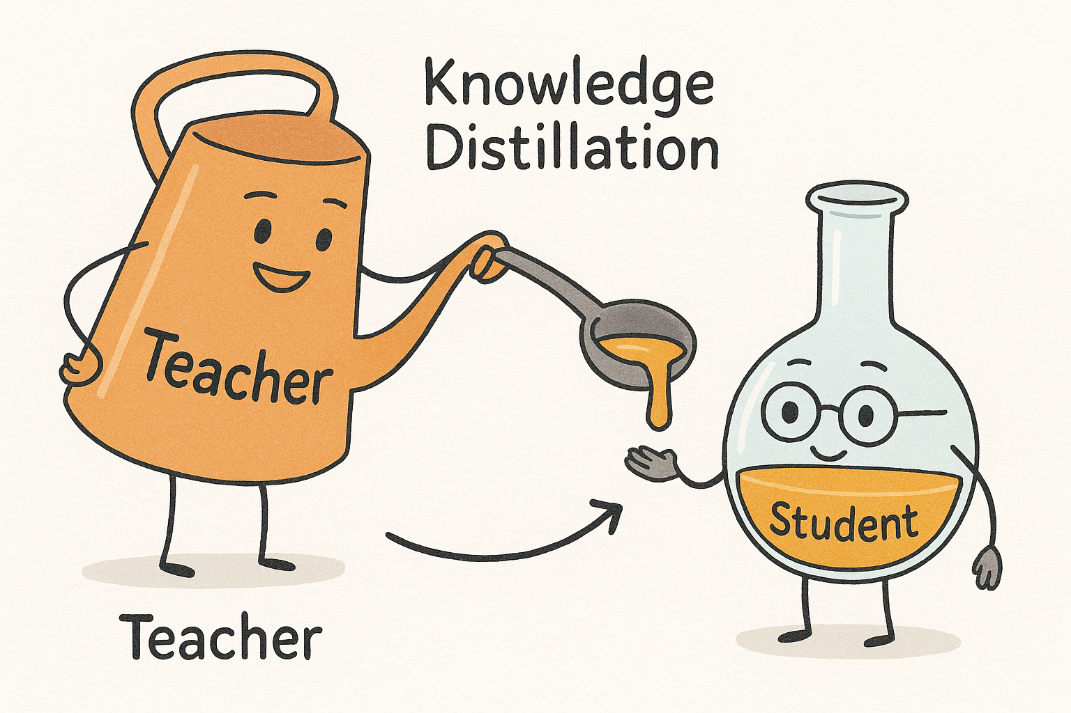
Knowledge Distillation

Slide 23
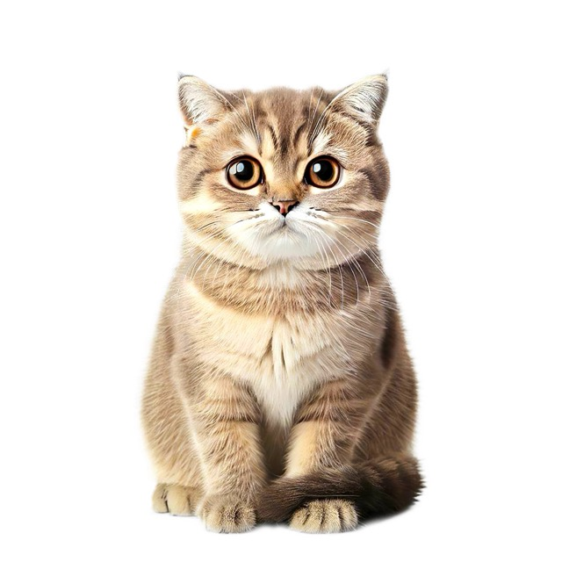
Teacher model and student model
Hinton, Geoffrey, Oriol Vinyals, and Jeff Dean. "Distilling the knowledge in a neural network." arXiv preprint arXiv:1503.02531 (2015).
越接近越好
^{T} probs
^{S} probs
取 softmax
取 softmax
^{T} logits
^{S} logits
Teacher model
(bigger)
Student model
(smaller)
(Input data)

Slide 24
Inference Speed-up

Slide 25
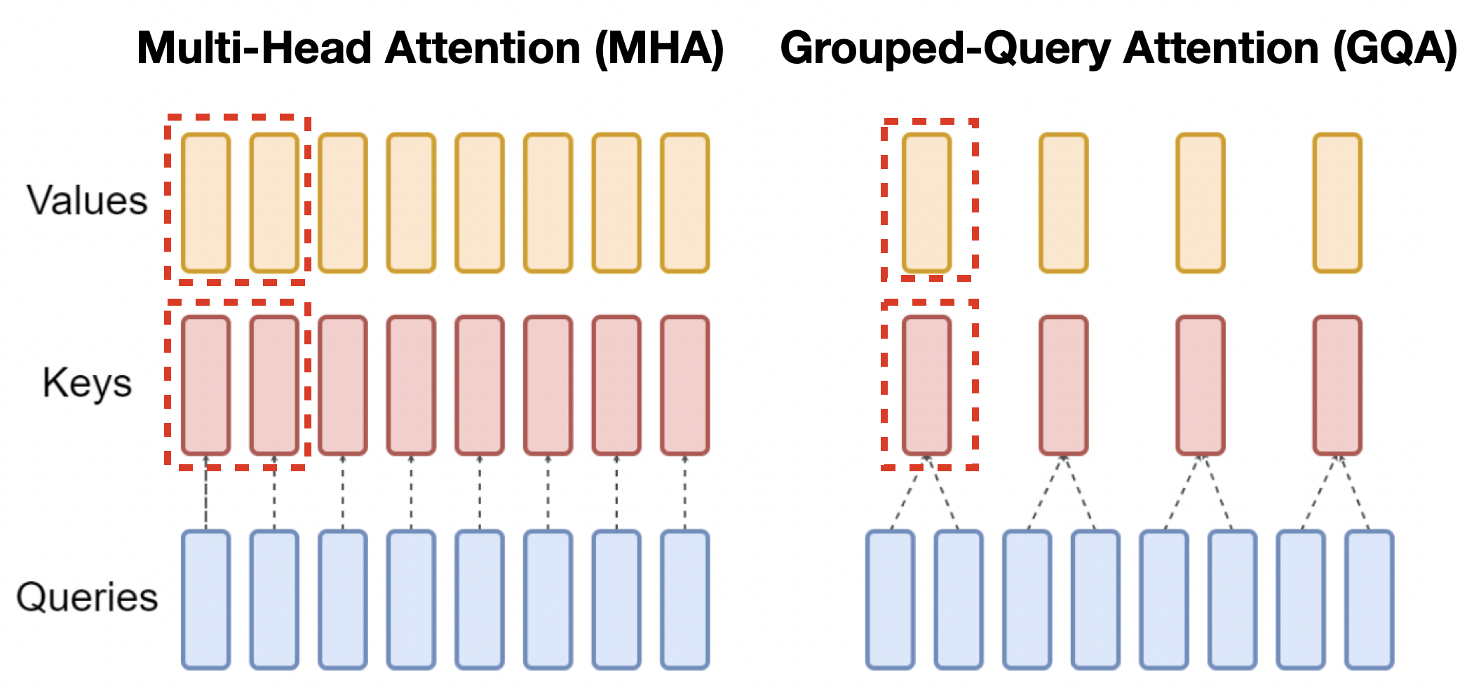
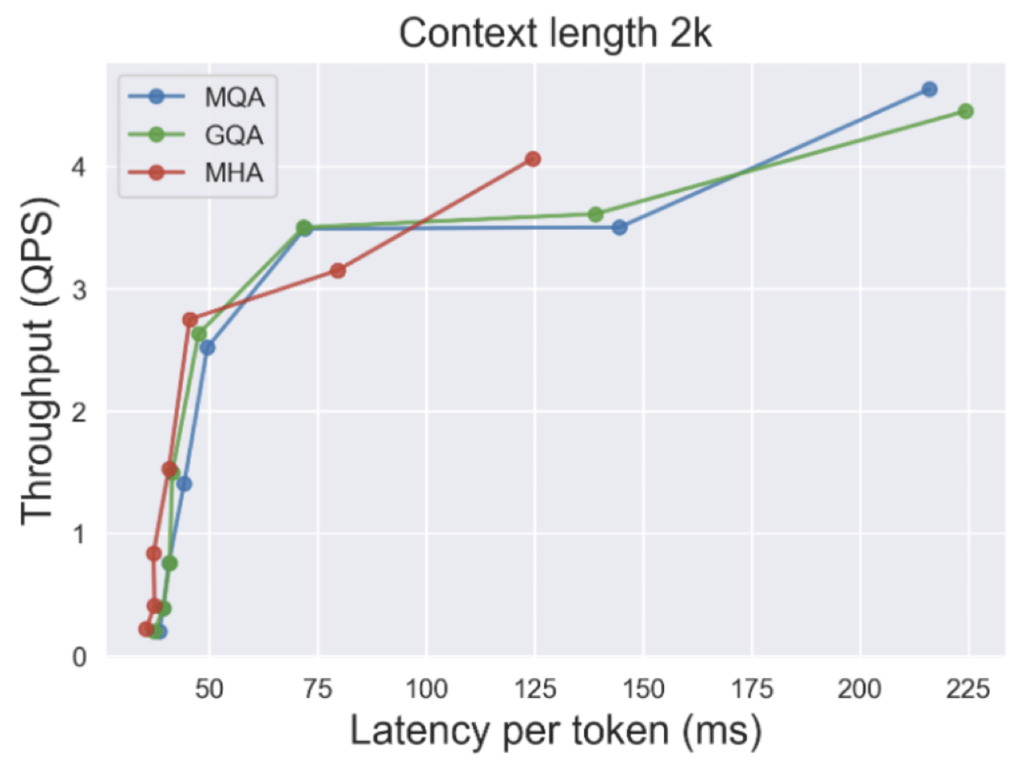
Grouped-Query Attention (GQA)
This technique is used during inference!
Mean Pooling
A pre-trained MHA model is required!
Ainslie, Joshua, et al. "GQA: Training Generalized Multi-Query Transformer Models from Multi-Head Checkpoints." arXiv preprint arXiv:2305.13245 (2023). Google Research Team.

Slide 26
Thank you!
Instructor: 林英嘉
✉️ yjlin@cgu.edu.tw
TA: 吳宣毅
✉️ m1161007@cgu.edu.tw

